Slide 1
Constraining models of neutron stars at saturation density
T K JHA
DEPARTMENT OF PHYSICS
BITS PILANI K K BIRLA GOA CAMPUS
20TH OF NOVEMBER 2014

Slide 2
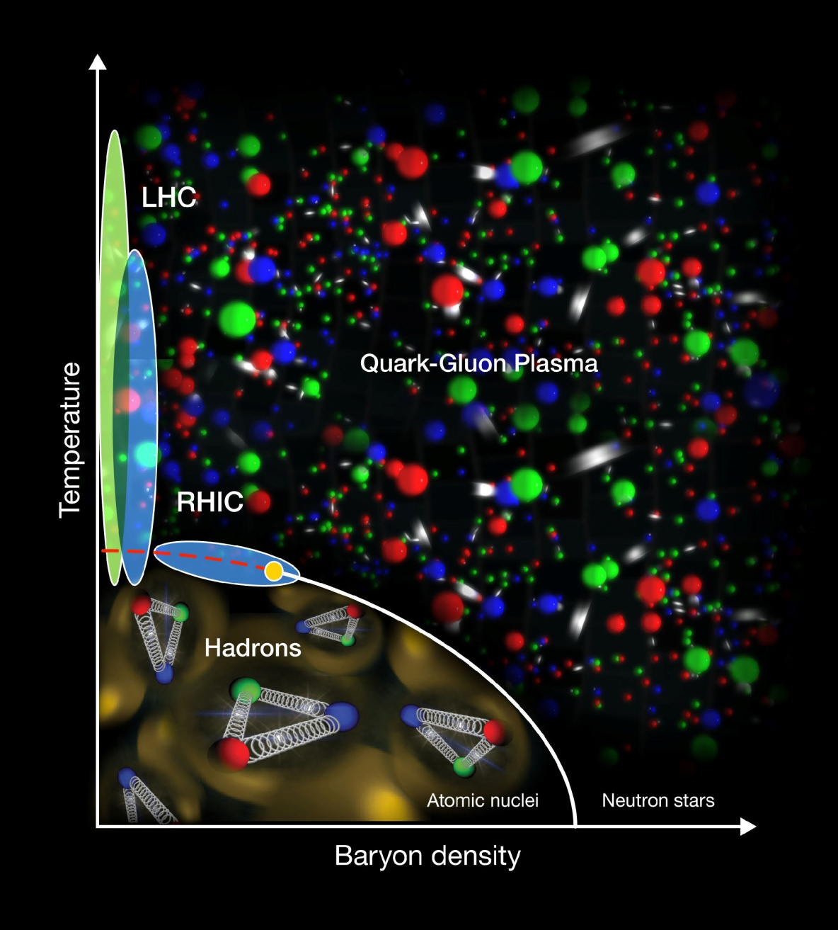
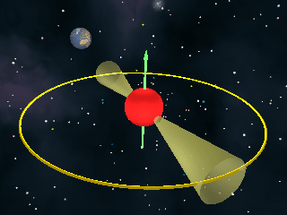
& Neutron Stars
QCD Phase Diagram

Slide 3

JOURNEY & THE DESTINATION
FINITE NUCLEI
NEUTRON STARS
THE DISTANCE IS ≈ 10 ρ_{ο}; extrapolation !!
?
Known by experiments
EQUATION OF STATE
Astrophysical observations

Slide 4
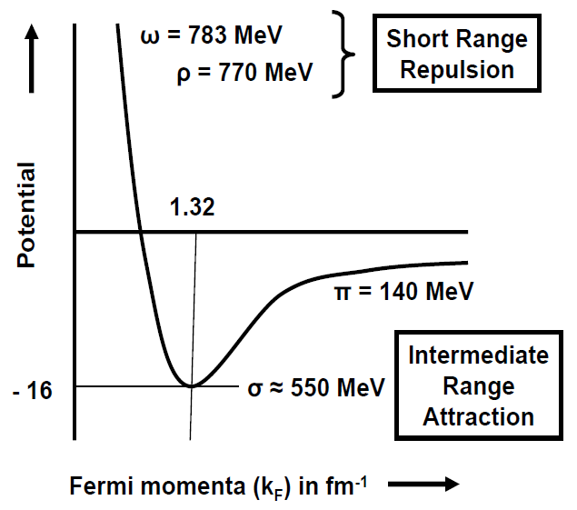
NUCLEAR SATURATION

Slide 5
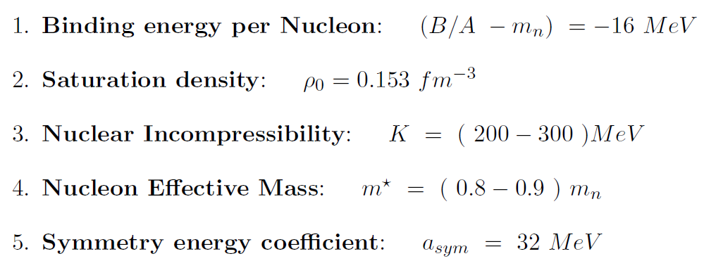
NUCLEAR MATTER SATURATIONPROPERTIES
NUCLEAR EOS TO DESCRIBE DENSE OBJECTS SUCH AS NEUTRON STARS MUST SATISFY THESE MINIMUM REQUIREMENTS
DEFINED AT T = 0

Slide 6
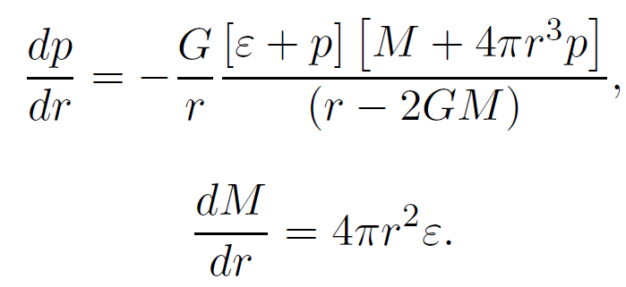
EQUATION OF STATE
NS = CRUST +CORE
NS = BPS
+
NUCLEONS/ HYPERONS/ QUARKS/ MIXED
ε/Р
ρ

Slide 7
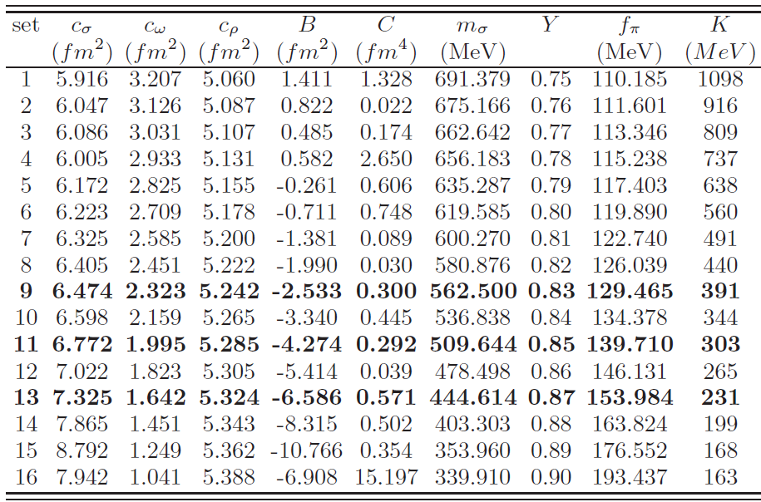
MODEL PARAMETERS:
Chiral sigma model@Mean Field
T K Jha & H Mishra, Phys.Rev. C78

Slide 8
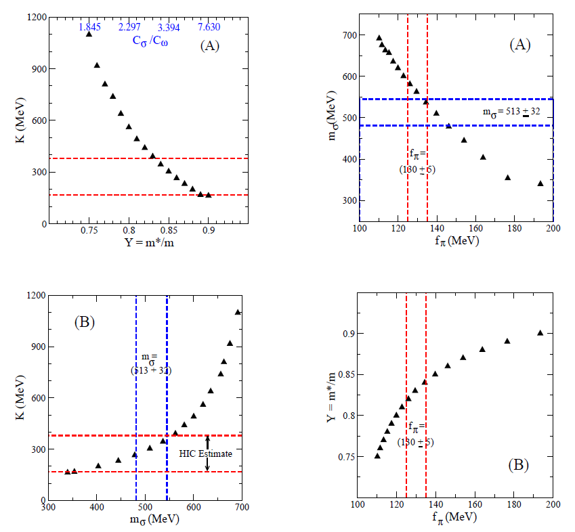
CONSTRAINTS: EXPERIMENTAL

Slide 9
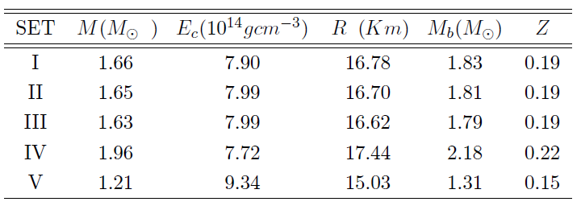
RESULTS: WITH HYPERONS
WINTER SCHOOL ON ACCELERATOR, NUCLEAR AND PARTICLE PHYSICS, BHU, 2014

Slide 10

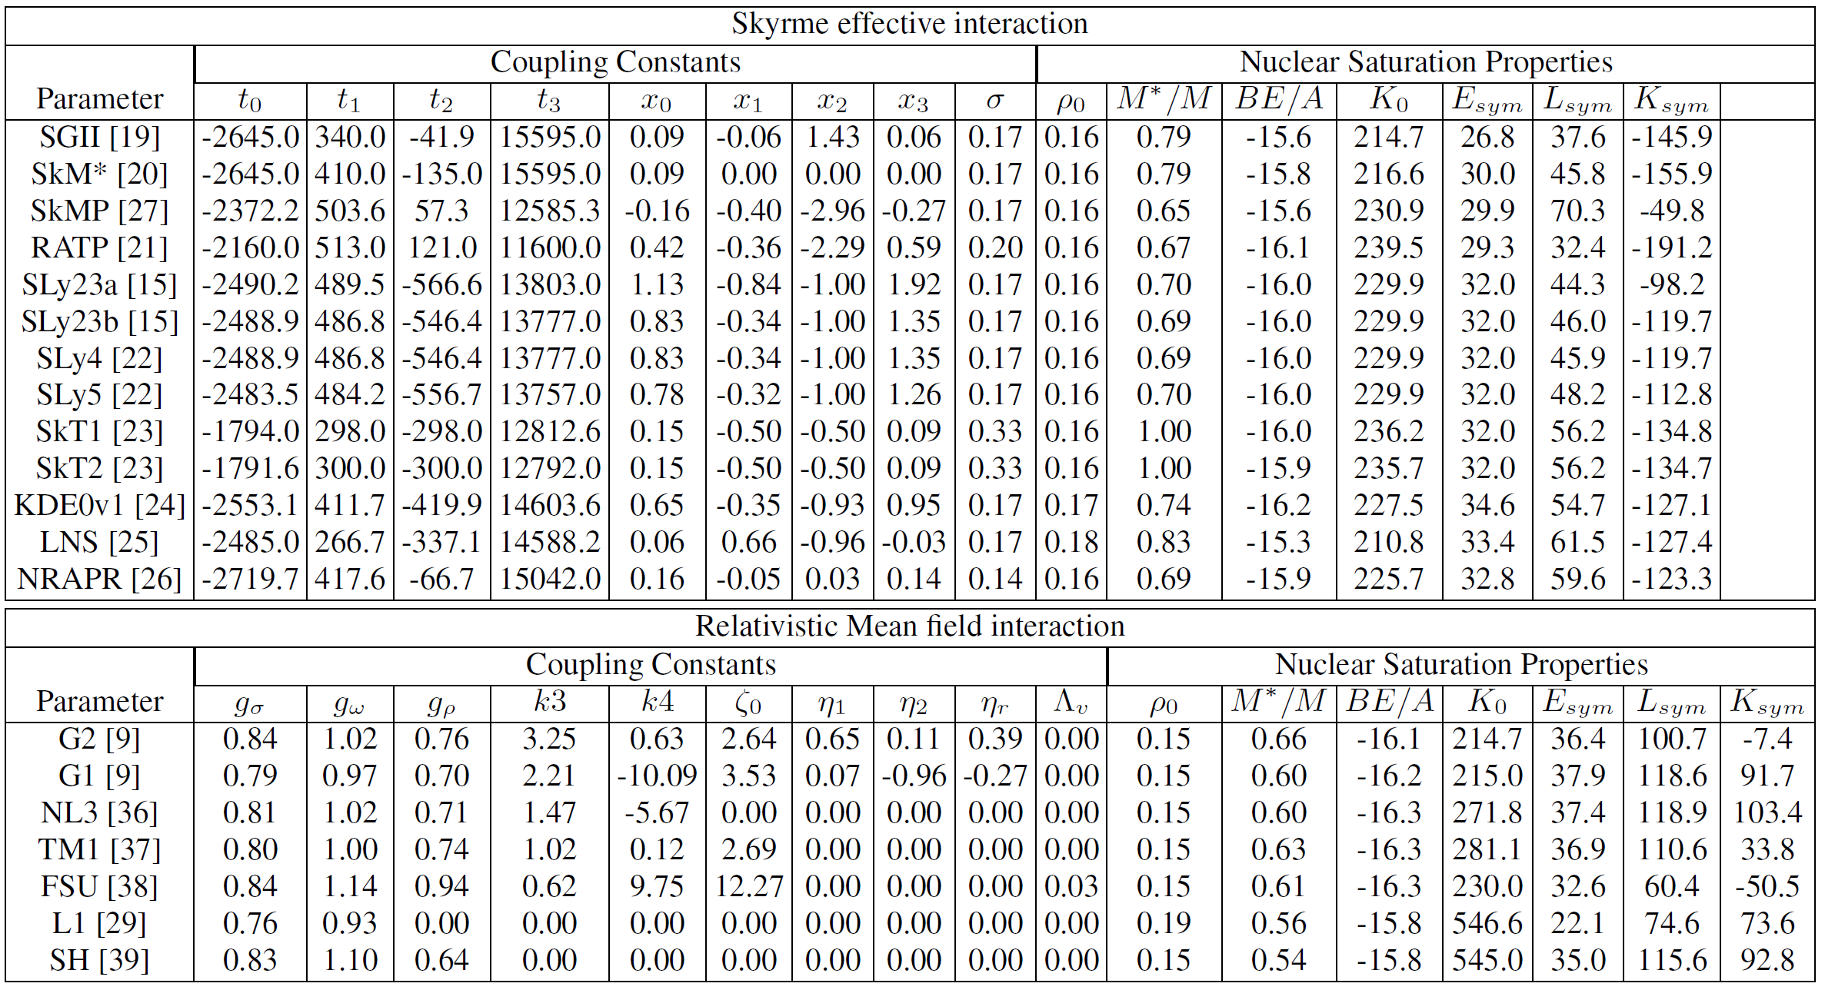
COMMUNICATED

Slide 11
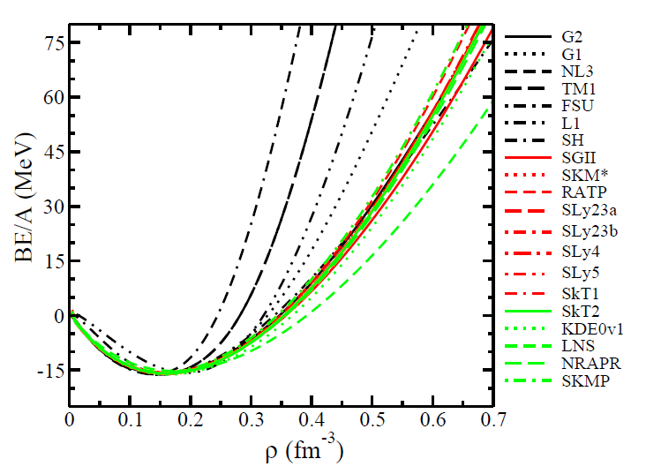

Slide 12
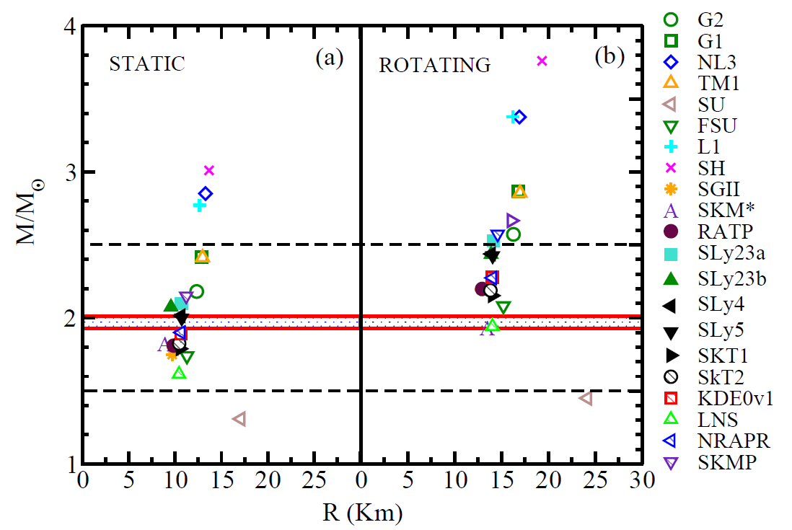

Slide 13

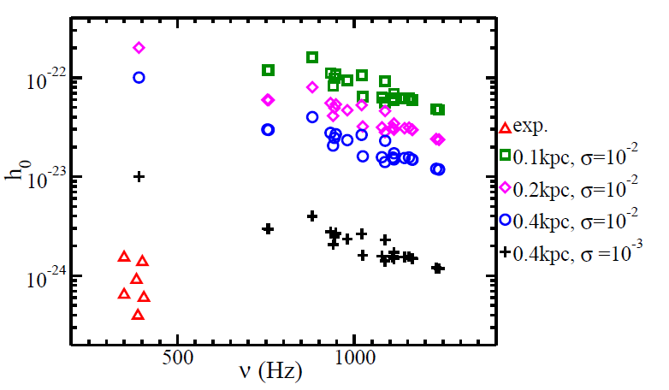
RESULTS: GW Strain Amplitude

Slide 14
Conclusion
Neutron stars are promising candidates to look for CGW. Advanced LIGO may be able to see them.
With dark matter interactions also, one can model Neutron stars to account for recently observed massive stars.

Slide 15

THANK YOU ALL FOR YOUR ATTENTION

