Slide 1


Quenched Superconductivity in Magnetars
Monika Sinha
Indian Institute of Technology Jodhpur
Armen Sedrakian
ITP, J. W. Goethe University, Frankfurt, Germany

Slide 2
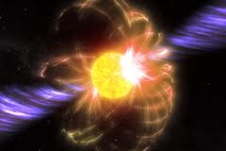
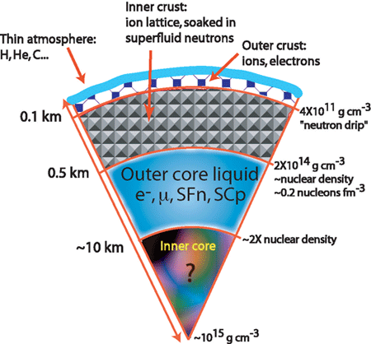
Magnetar… a new class of neutron stars
B_{s} = 10¹⁴ -10¹⁵ G
Interior field even greater
Superconductivity inside magnetar Quenched?

Slide 3

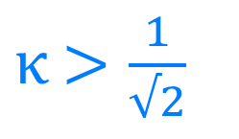

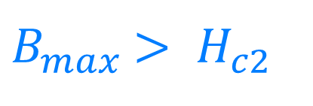
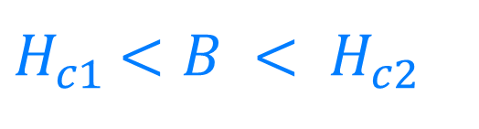

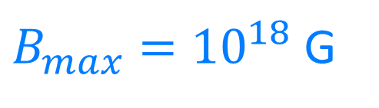
Motivation…
Type-II superconductivity
London’s penetration
depth
$κ$ $>\frac{1}{√2}$
$$κ= \frac{δ_{L}}{ξ_{p}}$$
Coherence length
Type-II superconductivity exists if
$H_{c2}$ = $\frac{Φ_{0}}{{2πξ_{p}}_{}^{2}}$
Quantum of flux
$H_{c1}$ $<B < H_{c2}$
$Φ_{0}$ = $\frac{nh}{2e}$
From virial theorem
$B_{max}$ $> H_{c2}$
$B_{max}={10}^{18}$ G

Slide 4
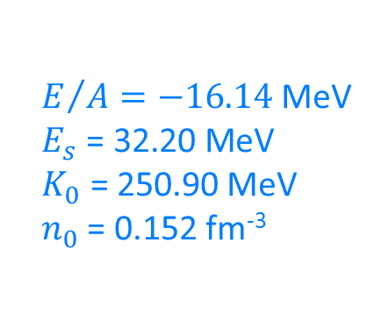
Inputs…
$E/{A=−16.14}$ MeV
$$E_{s}\text{ = 32.20 }\text{MeV}$$
$$K_{0}\text{ = 250.90 }\text{MeV}$$
$n_{0}$ = 0.152 fm⁻³

Slide 5
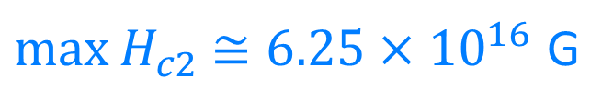
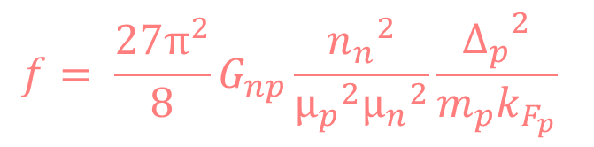
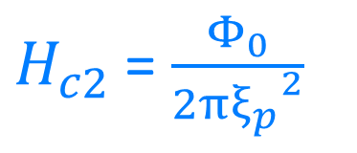
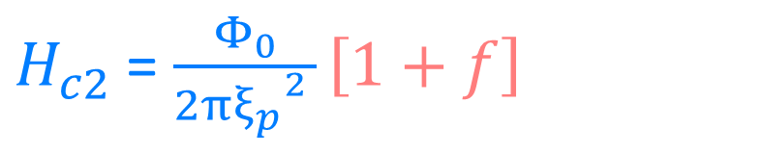
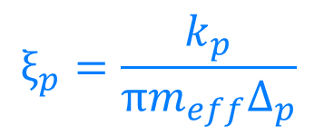
Results
$H_{c2}$ = $\frac{Φ_{0}}{{2πξ_{p}}_{}^{2 }}\left[1+f\right]$
$H_{c2}$ = $\frac{Φ_{0}}{{2πξ_{p}}_{}^{2}}$
$$ξ_{p}=\frac{k_{p}}{πm_{eff}Δ_{p}}$$
$$f= \frac{{27π}^{2}}{8}G_{np}\frac{{n_{n}}^{2}}{{μ_{p}}^{2}{μ_{n}}^{2}}\frac{{Δ_{p}}^{2}}{m_{p}k_{F_{p}}}$$
$\max{H_{c2}}$ $≅6.25×{10}^{16}$ G

Slide 6
Implications…
Electrical conductivity
Field decay
Rotational dynamics
glitch
cooling
Neutrino emissivity
Heat capacity
Reheating

Slide 7

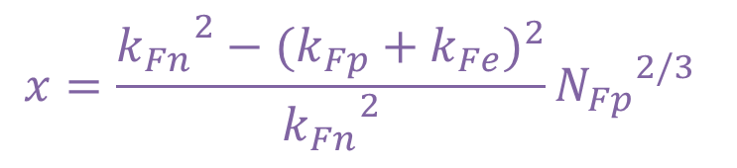
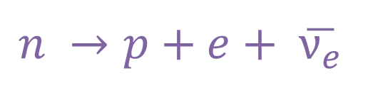


Emissivity
$$k_{Fn}$$
Neutrino emissivity
Direct Urca process
Pair-breaking process
$$n →p+e+ \overline{ν_{e}}$$
$$k_{Fp}$$
$$k_{Fe}$$
$$x=\frac{{k_{Fn}}_{}^{2}−{(k_{Fp}+k_{Fe})}^{2}}{{k_{Fn}}_{}^{2}}{N_{Fp}}_{}^{2/3}$$

Slide 8
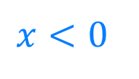
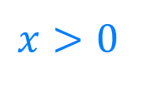
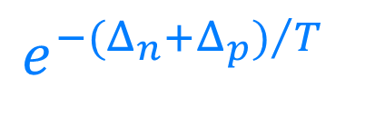
dUrca emissivity
$$e^{{−(Δ_{n}+Δ_{p})}/T}$$
$$x>0$$
$$x<0$$

Slide 9
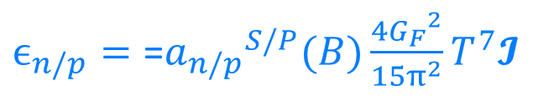
Pair-breaking emissivity
$ϵ_{n/p}=\text{=}{a_{n/p}}_{}^{S/P}(B)\frac{4{G_{F}}^{2}}{15π^{2}}T^{7}$𝓘

Slide 10
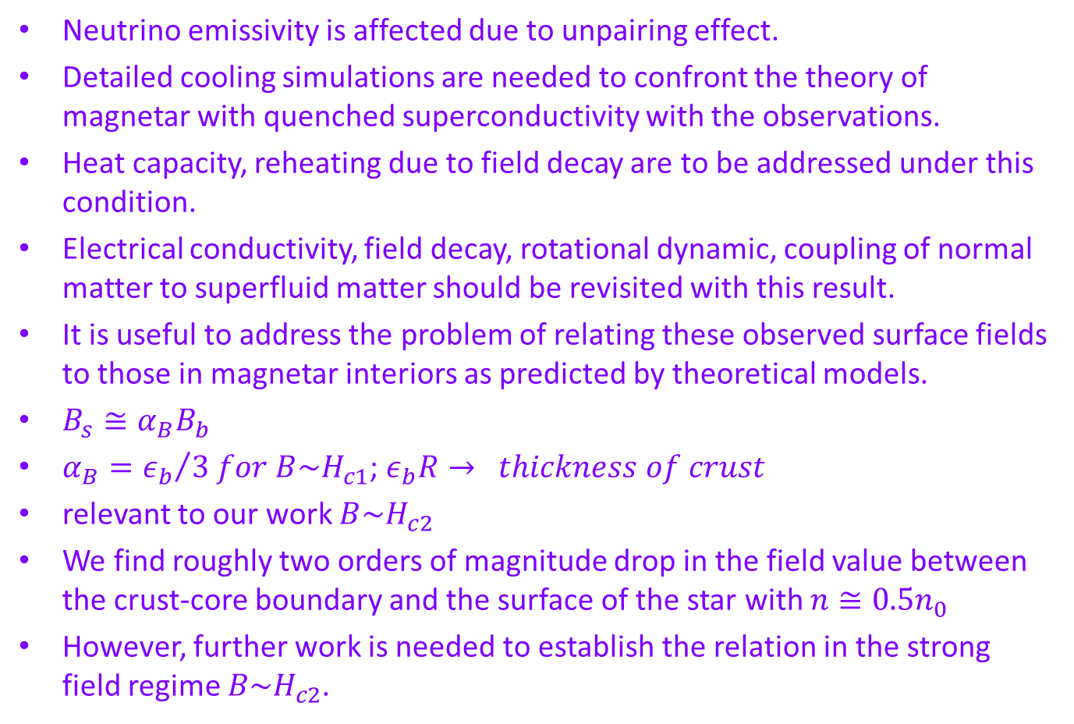
Summary and outlook
Neutrino emissivity is affected due to unpairing effect.
Detailed cooling simulations are needed to confront the theory of magnetar with quenched superconductivity with the observations.
Heat capacity, reheating due to field decay are to be addressed under this condition.
Electrical conductivity, field decay, rotational dynamic, coupling of normal matter to superfluid matter should be revisited with this result.
It is useful to address the problem of relating these observed surface fields to those in magnetar interiors as predicted by theoretical models.
$B_{s}≅α_{B}B_{b}$
$α_{B}={ε_{b}}/{3 for B\sim H_{c1}}$; $ε_{b}R→ thickness of crust$
relevant to our work $B\sim H_{c2}$
We find roughly two orders of magnitude drop in the field value between the crust-core boundary and the surface of the star with $n≅0.5n_{0}$
However, further work is needed to establish the relation in the strong field regime $B\sim H_{c2}$.

